Slide 1
Major Syntax Differences in C and C++
Understanding the Key Distinctions
- A PRESENTATION BY ANANT AGARWAL

Slide 2
Object-Oriented Programming (OOP) Support
C:- Procedural programming language, no classes or objects.
C++:- Supports OOP, allowing classes and objects.
C Example:
// C
struct Point {
int x;
int y;
};
C++ Example:
// C++
class Point {
public:
int x;
int y;
};

Slide 3
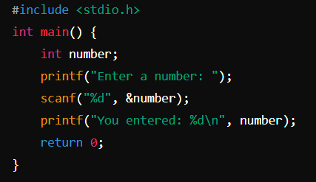
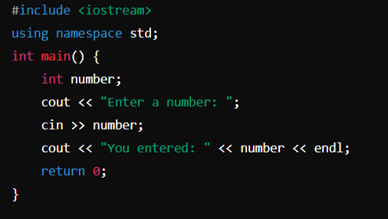
Standard Input and Output
C:- Uses printf and scanf for input and output.
C++:- Uses cin and cout with the iostream library.
C Example:
#include <stdio.h>
int main() {
int number;
printf("Enter a number: ");
scanf("%d", &number);
printf("You entered: %d\n", number);
return 0;
}
C++ Example:
#include <iostream>
using namespace std;
int main() {
int number;
cout << "Enter a number: ";
cin >> number;
cout << "You entered: " << number << endl;
return 0;
}

Slide 4
Function Overloading and Namespaces
Function Overloading:
C:- Does not support function overloading.
C++:- Supports function overloading, allowing multiple functions with the same name but different parameters.
Namespaces:
C:- Does not support namespaces.
C++:- Supports namespaces to avoid name conflicts.

Slide 5
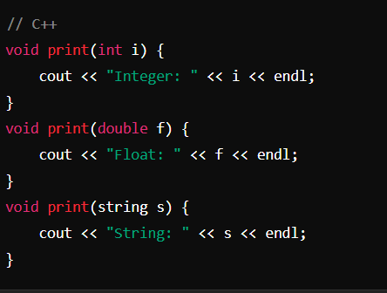
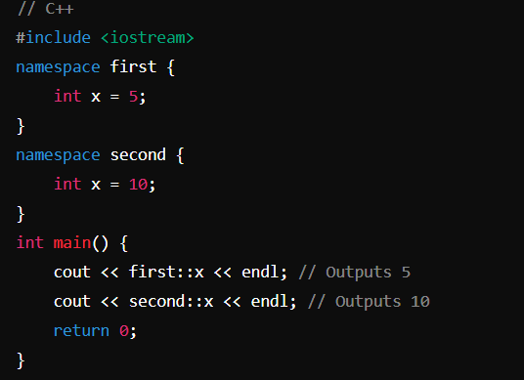
C++ Example (Function Overloading):
void print(int i) {
cout << "Integer: " << i << endl;
}
void print(double f) {
cout << "Float: " << f << endl;
}
void print(string s) {
cout << "String: " << s << endl;
C++ Example (Namespaces):
#include <iostream>
namespace first {
int x = 5;
}
namespace second {
int x = 10;
}
int main() {
cout << first::x << endl;
cout << second::x << endl;
return 0;
}

Slide 6
Memory Management and Type Safety
Memory Management:
C:- Uses malloc and free for dynamic memory allocation.
C++:- Uses new and delete for dynamic memory allocation.
Type Safety:
C:- Less type-safe; implicit conversions are more common.
C++:- More type-safe; stricter type checking.

Slide 7
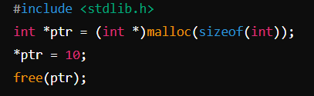
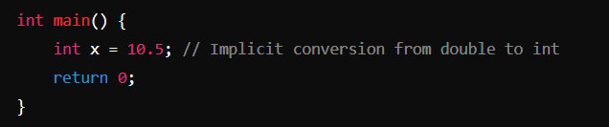
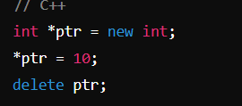
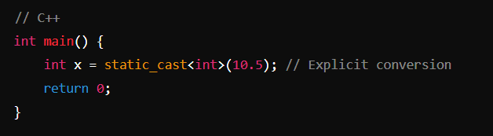
C Example (Memory Management):
#include <stdlib.h>
int *ptr = (int *)malloc(sizeof(int));
*ptr = 10;
free(ptr);
C++ Example (Memory Management):
int *ptr = new int;
*ptr = 10;
delete ptr;
C Example (Type Safety):
int main() {
int x = 10.5; // Implicit conversion from double to int
return 0;
}
C++ Example (Type Safety):
int main() {
int x = static_cast<int>(10.5); // Explicit conversion
return 0;
}

Slide 8
References, Inline Functions, STL
References:
C:- Does not support references.
C++:Supports references, which are safer and easier to use than pointers.
Inline Functions:
C:- Uses macros for inline functionality.
C++:- Supports inline functions, which are safer and provide better type checking.
Standard Template Library (STL):
C:- Does not have STL.
C++:- Has STL, providing a rich set of template classes and functions for data structures and algorithms.

Slide 9

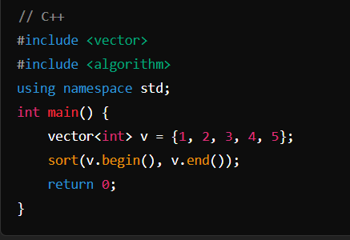
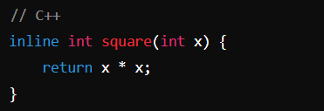
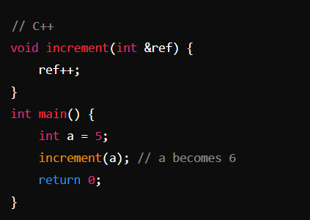
C Example (Inline Functions):
#define SQUARE(x) ((x) * (x))
C++ Example (Inline Functions):
inline int square(int x) {
return x * x;
}
C++ Example (STL):
#include <vector>
#include <algorithm>
using namespace std;
int main() {
vector<int> v = {1, 2, 3, 4, 5};
sort(v.begin(), v.end());
return 0;}
C++ Example (References):
void increment(int &ref) {
ref++;
}
int main() {
int a = 5;
increment(a); // a becomes 6
return 0;}

Slide 10
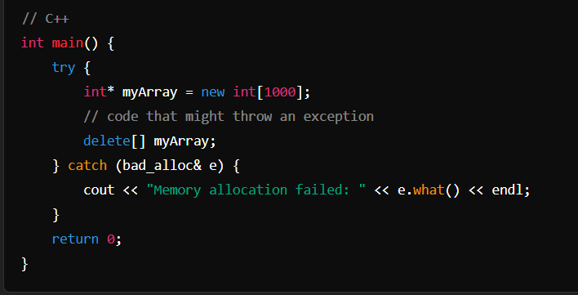
Exception Handling
C:- Uses error codes and manual error checking.
C++:- Supports exception handling with try, catch, and throw.
C++ Example:
int main() {
try {
int* myArray = new int[1000];
// code that might throw an exception
delete[] myArray;
} catch (bad_alloc& e) {
cout << "Memory allocation failed: " << e.what() << endl;
}
return 0;
}

Slide 11
Call to Action
Explore the full potential of C++ for your projects. Leverage its powerful features and advanced capabilities to build robust and efficient software. Start coding with C++ today!

